Slide 2
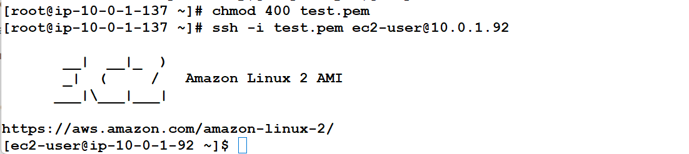
Connected from the bastion host to the webserver in the public subnet

Slide 3
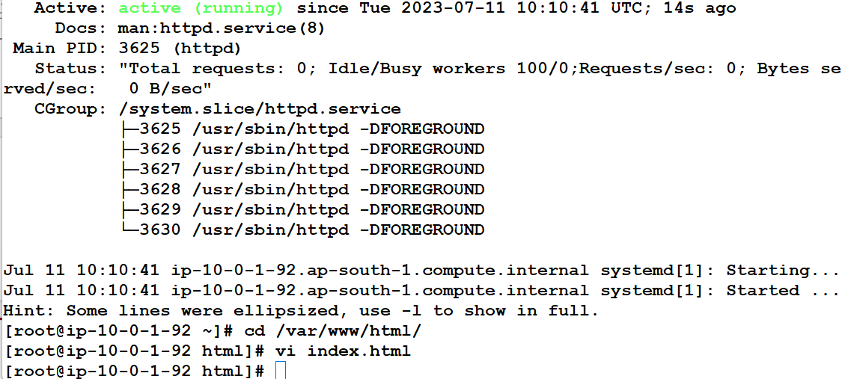

Httpd installed in the webserver at public subnet. Public ip gives connectivity to webserver in public subnet
Static content is hosted :"Welcome To The Webserver at Public Subnet"

Slide 4
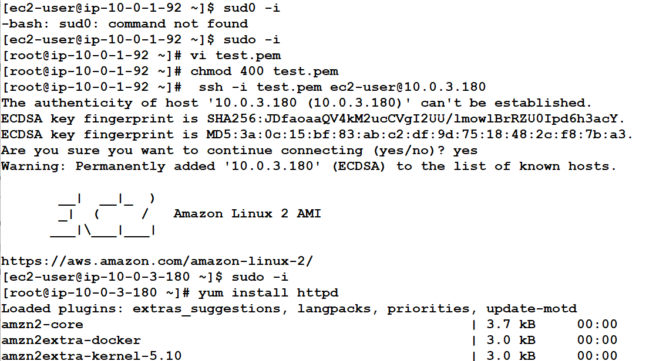
With natgateway connected to appserver 1 and appserver 2 and installed httpd in appserver1 and tomcat in appserver2

Slide 5
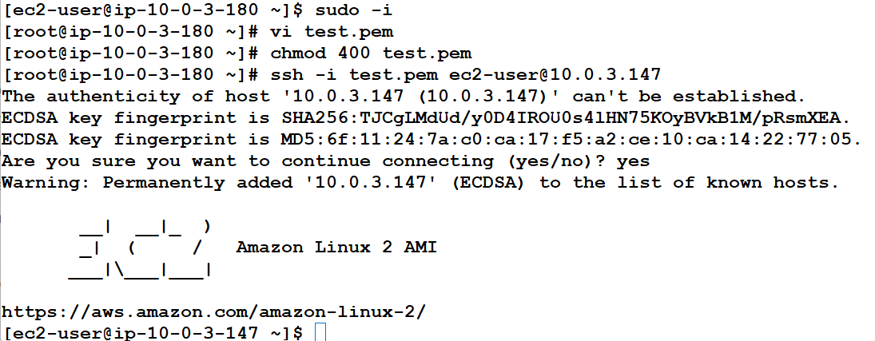




Connected from appserver1 to appserver 2
Nginx installed and started in appserver 2

Slide 6

Using cname type routing, using DNS of ELB

Slide 7
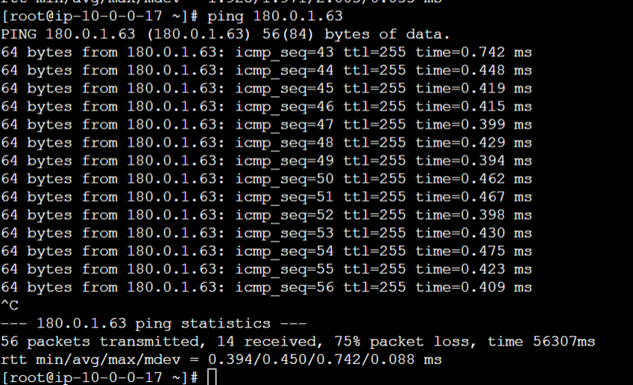
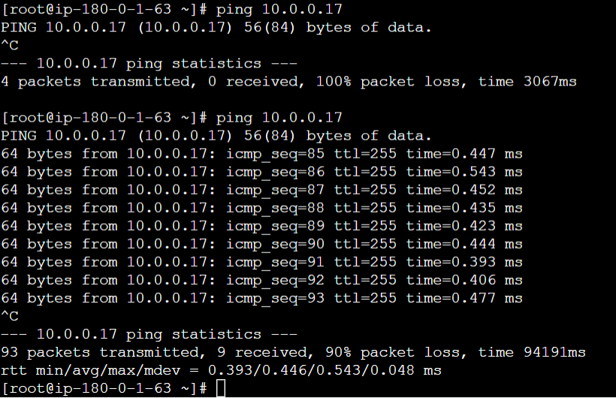
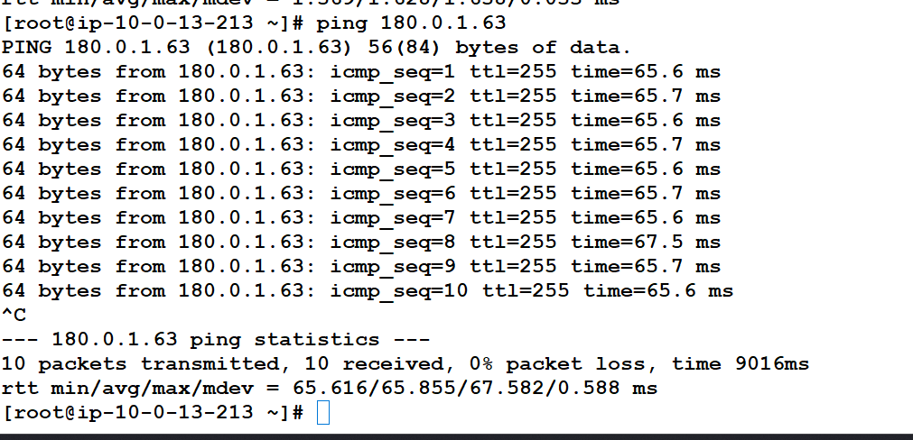

Slide 8




